Slide 1

eBay Used Car Data: Exploratory Data Analysis
Nitin Mahajan
Final Project DSC530
Bellevue University

Slide 2
OBJECTIVE
Identification of Significant variables to drive the price of used cars in eBay
DATA SOURCE
Used Cars Database from Kaggle
https://www.kaggle.com/piumiu/used-cars-database-50000-data-points

Slide 3
Exploratory Data Analysis - Summary
The dataset consists of 20 columns
15 columns contain data of object type, 5 columns are int.64 type.
5 columns have missing values, but none of them contain more than 20% missing values
Units of the variables are missing,

Slide 4
CORRELATION MATRIX

Slide 5
Distribution of Variables
Price
Years of Registration
- Right skewed (positively skewed)
Left skewed (Negatively skewed)
Odometer
Registration Month
Left skewed (Negatively skewed)
Normally Distributed

Slide 6
Probability Mass Function (PMF)

Slide 7
Cumulative Distribution Function (CDF)
- approx 25% cars have reading under 100000 km, and about 30% cars under 120000 kilometer.
- Common values appear vertical sections of the CDF; there are fewer values below 100000 kilometer, so the CDF in this range is flatter.

Slide 8
Analytical Distribution

Slide 9
Scatter Plot
Car price vs the power of the car in PS.
(Excluding low powerPS values)
powerPS and Car price have positive but weak correlation.

Slide 10
Scatter Plot
Age and price
(Excluded newer cars since their price is expected to be higher).
- Age is one of the factors that causes the price to change.
Presence of few outliers for cars older than 35 years with high price range
-Weak association of Car age and price.

Slide 11
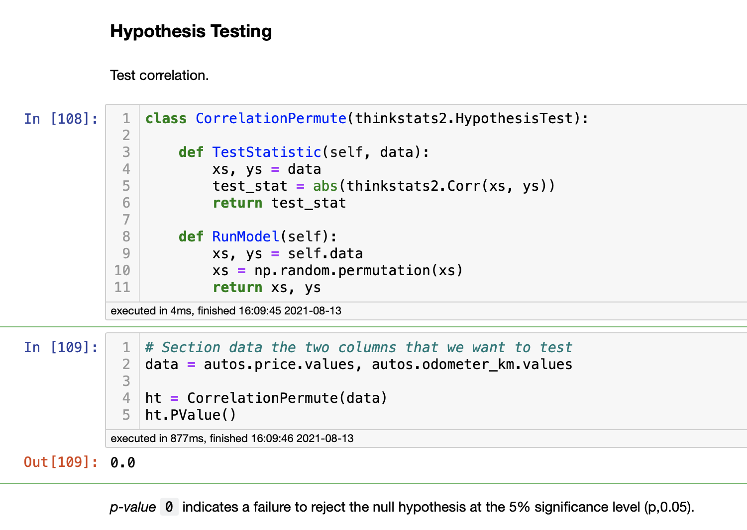
Hypothesis Testing

Slide 12
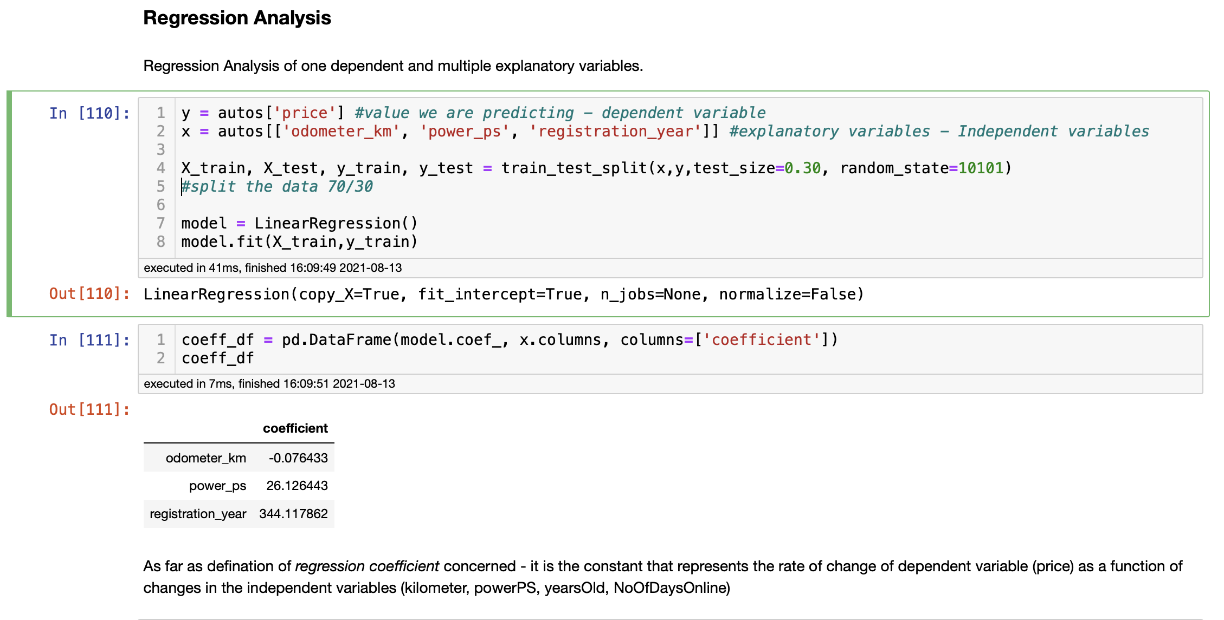
REGRESSION ANALYSIS

Slide 13
Thank you

